Slide 1

Przetwarzanie wielkich grafów: Apache Spark
Aleksander Ciepiela
Rafał Grabiański
Marcin Ziąber

Slide 2
What is Apache Spark?
“Apache® Spark™ is a powerful open source processing engine built around speed, ease of use, and sophisticated analytics. It was originally developed at UC Berkeley in 2009.”

Slide 3
What is Apache Spark?
Provides an application programming interface centered on a data structure called resilient distributed dataset (RDD) - a read-only multiset of data items distributed over a cluster of machines, that is maintained in a fault-tolerant way
Developed in response to limitations in the MapReduce cluster computing paradigm which forces a particular linear dataflow structure on distributed programs

Slide 4
MapReduce
Read data from disk -> map -> reduce -> store results on disk

Slide 5
RDD
Spark’s RDDs function as a working set for distributed programs that offers a restricted form of distributed shared memory
Facilitates the implementation of both iterative algorithms, that visit their dataset multiple times in a loop, and interactive/exploratory data analysis
Especially useful for training algorithms for machine learning systems and graph processing algorithms

Slide 6
What is Apache Spark?
Requires a cluster manager and a distributed storage system
Cluster manager: Hadoop YARN, Apache Mesos ...
Distributed storage system: HDFS, Cassandra, Amazon S3 …
Supports pseudo-distributed local mode for development and testing: local file system and one executor per CPU core

Slide 7
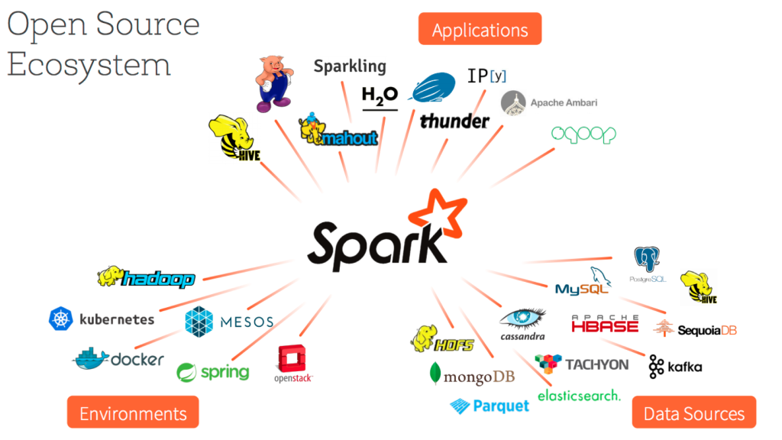

Slide 8
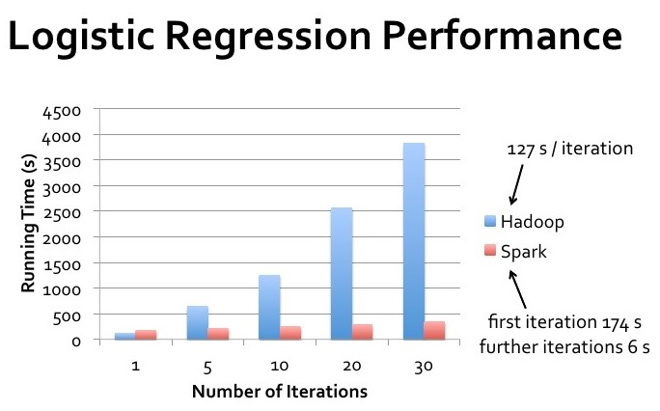

Slide 9
Spark - GraySort 2014 winner
An industry benchmark on how fast a system can sort 100 TB of data
Previous world record: 72 minutes, Hadoop MapReduce cluster of 2100 nodes (Yahoo)
New record: 23 minutes, 206 EC2 nodes
3X faster using 10X fewer machines

Slide 10
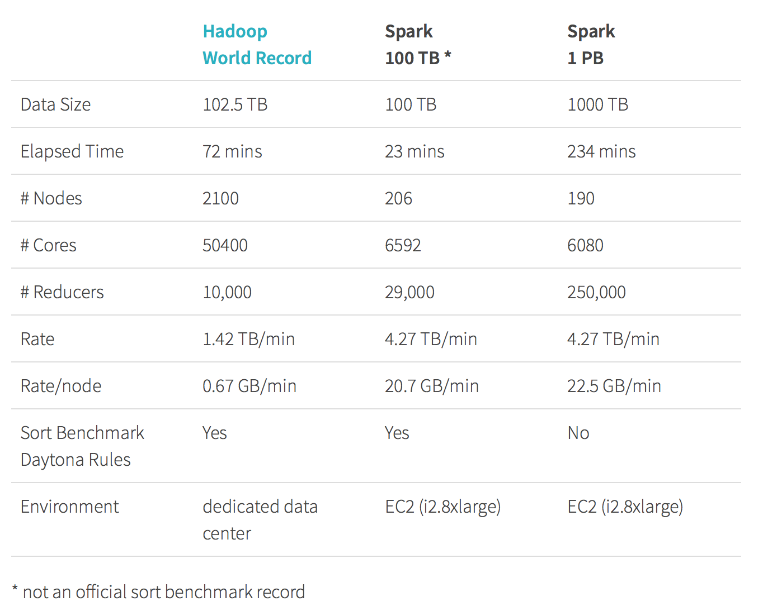
Spark - GraySort 2014 winner

Slide 11
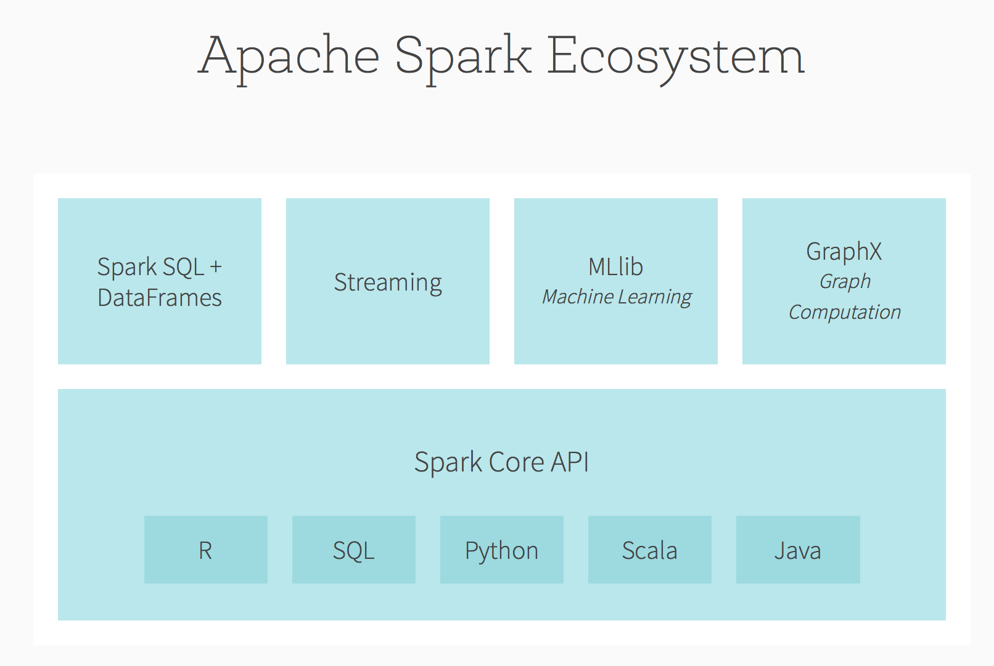

Slide 12
Spark Core
Provides distributed task dispatching, scheduling, basic I/O exposed through an API
Supports a functional/higher-order model of programming: map, filter, reduce etc.
Spark schedules the function’s execution in parallel on the cluster
Operations take RDDs as input and produce new RDDs - they are immutable and lazy evaluated
Fault tolerance is achieved by keeping track of the lineage of each RDD (the sequence of operations that produced it) so that it can be reconstructed in the case of data loss

Slide 13
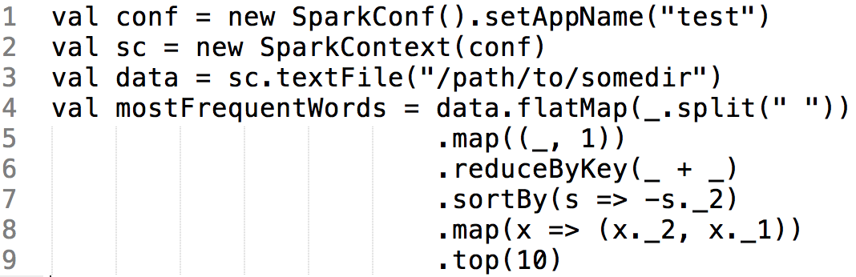
Example: Top 10 most frequent words

Slide 14
Spark SQL
Introduces a data abstraction called DataFrames which provides support for structured and semi-structured data.
Provides domain-specific language to manipulate DataFrames
Provides SQL language support with command-line interfaces and ODBC/JDBC server

Slide 15
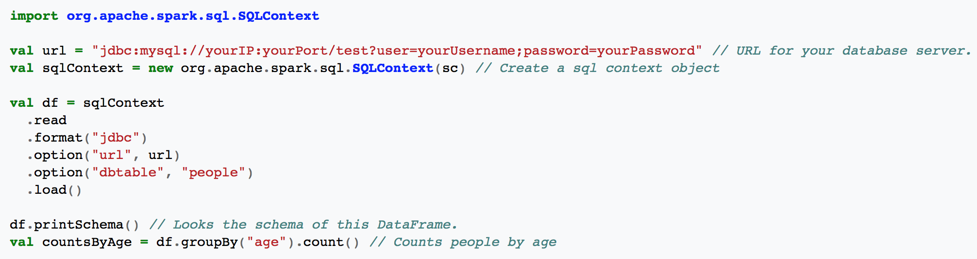
Example: Count people by age

Slide 16
Streaming
Leverages Spark Core’s fast scheduling capability to perform streaming analytics
Ingests data in mini-batches and performs RDD transformations on those mini-batches of data. It enables the same set of application code written for batch analytics to bes used in streaming analytics (lambda architecture)
Penalty of latency equal to the mini-batch duration
Consumes data from Kafka, Flume, Twitter, Kinesis, TCP/IP sockets etc.

Slide 17
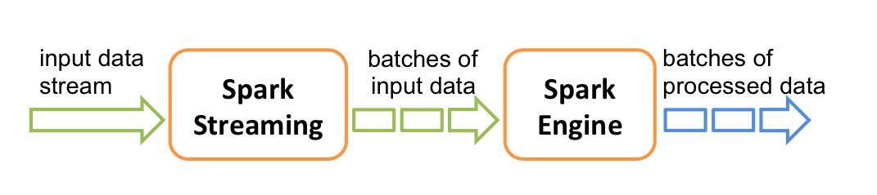
Streaming

Slide 18
MLib - machine learning library
Distributed machine learning framework on top of Spark Core
Due to its distributed memory-based architecture it is up to nine times faster than disk-based implementation used by Apache Mahout
Many common machine learning and statistical algorithms have been implemented and are shipped with MLib which simplifies large scale machine learning pipelines

Slide 19
MLib - some included algorithms
Summary statistics, correlations, random data generation
Classification and regression: support vector machines, linear regression, decision trees
Cluster analysis methods: k-means, Latent Dirichlet Allocation (LDA)
Dimensionality reduction techniques: singular value decomposition (SVD), principal component analysis (PCA)
Optimization algorithms: stochastic gradient descent, limited-memory BFGS (L-BFGS)

Slide 20
GraphX
“GraphX is a new component (alpha) in Spark for graphs and graph-parallel computation.”
extends the Spark RDD by introducing a new Graph abstraction: a directed multigraph with properties attached to each vertex and edge.
Introduces:
set of fundamental graph operators (e.g., subgraph, joinVertices, and aggregateMessages)
optimized variant of the Pregel API

Slide 21
Property Graph
Directed multigraph with user defined objects attached to each vertex and edge
Like RDDs, property graphs are immutable, fault-tolerant and distributed
GraphX optimizes the representation of edge and vertex types when they are primitive data types by using specialized arrays (memory footprint reduction)
Each Vertex is keyed by a unique 64-bit long id

Slide 22
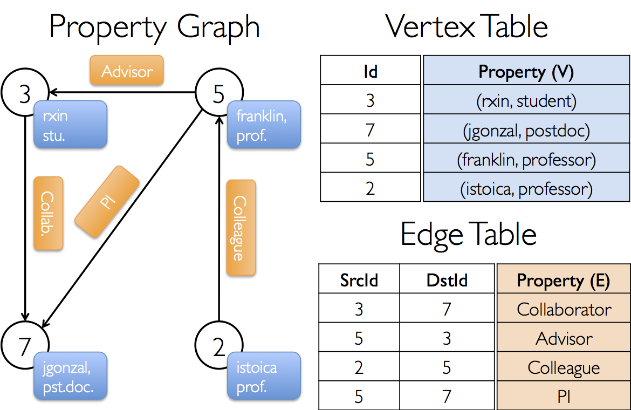
Example Property Graph
val userGraph: Graph[(String, String), String]
// Create an RDD for the vertices val users: RDD[(VertexId, (String, String))] = sc.parallelize(Array((3L, ("rxin", "student")), (7L, ("jgonzal", "postdoc")), (5L, ("franklin", "prof")), (2L, ("istoica", "prof")))) // Create an RDD for edges val relationships: RDD[Edge[String]] = sc.parallelize(Array(Edge(3L, 7L, "collab"), Edge(5L, 3L, "advisor"), Edge(2L, 5L, "colleague"), Edge(5L, 7L, "pi"))) // Define a default user in case there are relationship with missing user val defaultUser = ("John Doe", "Missing") // Build the initial Graph val graph = Graph(users, relationships, defaultUser)

Slide 23
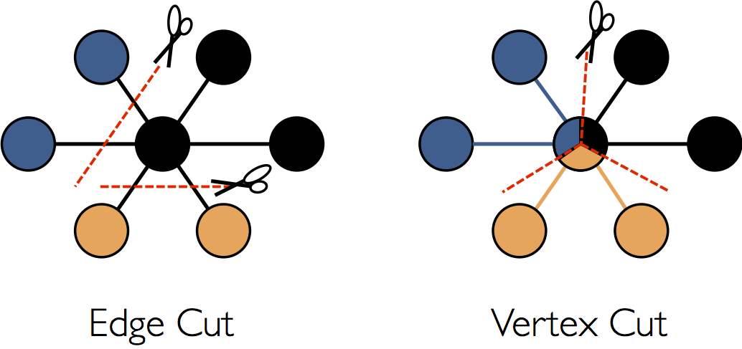
Graphs distribution
In order to optimize graphs parallel processing they are distributed across the executors using vertex-cut approach.
The exact method of assigning edges depends on PartitionStrategy. User can choose between different heuristics.

Slide 24
Graph views
Edge view:
graph.edges
Vertex view:
graph.vertices
Triplet view:
graph.triplet

Slide 25
Graph operators
// Information about the Graph val numEdges: Long val numVertices: Long val inDegrees: VertexRDD[Int] val outDegrees: VertexRDD[Int] val degrees: VertexRDD[Int]
// Transform vertex and edge attributes
def mapVertices[VD2](map: (VertexID, VD) => VD2): Graph[VD2, ED]
def mapEdges[ED2](map: Edge[ED] => ED2): Graph[VD, ED2] def mapTriplets[ED2](map: EdgeTriplet[VD, ED] => ED2): Graph[VD, ED2]
// Functions for caching graphs (by default they are not cached in memory) def persist(newLevel: StorageLevel = StorageLevel.MEMORY_ONLY): Graph[VD, ED] def cache(): Graph[VD, ED] def unpersistVertices(blocking: Boolean = true): Graph[VD, ED]

Slide 26
// Modify the graph structure
def reverse: Graph[VD, ED] def subgraph( epred: EdgeTriplet[VD,ED] => Boolean = (x => true), vpred: (VertexID, VD) => Boolean = ((v, d) => true)) : Graph[VD, ED]
def mask[VD2, ED2](other: Graph[VD2, ED2]): Graph[VD, ED]
def groupEdges(merge: (ED, ED) => ED): Graph[VD, ED]
// Basic graph algorithms def pageRank(tol: Double, resetProb: Double = 0.15): Graph[Double, Double]
def connectedComponents(): Graph[VertexID, ED]
def triangleCount(): Graph[Int, ED]
def stronglyConnectedComponents(numIter: Int): Graph[VertexID, ED]

Slide 27
What’s more...
GraphX supports more complex operations like:
Iterative like graph-parallel computation
Joining RDDs with graph
Aggregation of informations about adjacent triplets

Slide 28
Supported graph algorithms
PageRank
ConnectedComponents
StronglyConnectedComponents
TriangleCounting

Slide 29
PageRank
PageRank works by counting the number and quality of links to a page to determine a rough estimate of how important the website is. The underlying assumption is that more important websites are likely to receive more links from other websites.
PageRank is a link analysis algorithm and it assigns a numerical weighting to each element of a hyperlinked set of documents, such as the WWW, with the purpose of "measuring" its relative importance within the set.

Slide 30
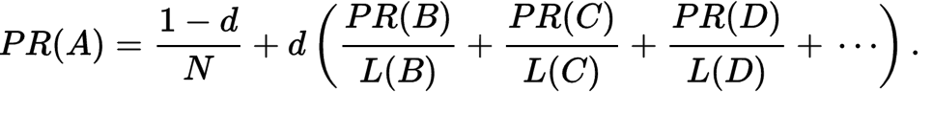
PageRank
PR(X) - PageRank value for page (vertex) X
d - damping factor - probability that the surfer will continue
N - number of pages (vertices)
L(X) - number of X outbound links

Slide 31
PageRank in GraphX
GraphX comes with static and dynamic implementations of PageRank
static PageRank runs for a fixed number of iterations
dynamic PageRank runs until the ranks converge (i.e., stop changing by more than a specified tolerance)
May be performed using PageRank object or directly by calling methods on Graph object

Slide 32
PageRank in GraphX
// Run PageRank val ranks = graph.pageRank(0.0001).vertices // Join the ranks with the usernames val users = sc.textFile("data/graphx/users.txt").map { line => val fields = line.split(",") (fields(0).toLong, fields(1)) } val ranksByUsername = users.join(ranks).map { case (id, (username, rank)) => (username, rank) }

Slide 33
Connected components - definition
Connected component (or just component) of an undirected graph is a subgraph in which any two vertices are connected to each other by paths, and which is connected to no additional vertices in the supergraph.

Slide 34
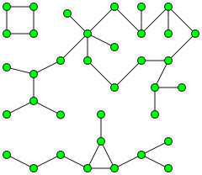
Connected components

Slide 35
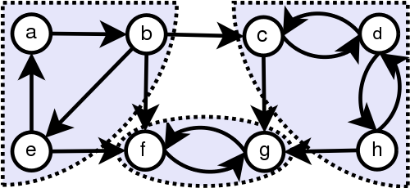
Strongly connected components - definition
In the mathematical theory of directed graphs, a graph is said to be strongly connected or disconnected if every vertex is reachable from every other vertex.

Slide 36
Connected components in GraphX
The connected components algorithm labels each connected component of the graph with the ID of its lowest-numbered vertex
// Find the connected components val cc = graph.connectedComponents().vertices
val cc = graph.stronglyConnectedComponents(10).vertices

Slide 37
Triangle counting
The triangle is a three-node small graph, where every two nodes are connected.
GraphX requires that:
the edges to be in canonical orientation (srcId < dstId)
graph to be partitioned using Graph.partitionBy

Slide 38
Triangle count - algorithm
GraphX counts the triangles passing through each vertex using a straightforward algorithm:
Compute the set of neighbors for each vertex;
For each edge compute the intersection of the sets and send the count to both vertices
Compute the sum at each vertex and divide by two since each triangle is counted twice

Slide 39
Triangle count - example
// Load the edges in canonical order and partition the graph for triangle count val graph = GraphLoader.edgeListFile(sc, "data/graphx/followers.txt", true) .partitionBy(PartitionStrategy.RandomVertexCut) // Find the triangle count for each vertex val triCounts = graph.triangleCount().vertices // Join the triangle counts with the usernames val users = sc.textFile("data/graphx/users.txt").map { line => val fields = line.split(",") (fields(0).toLong, fields(1)) } val triCountByUsername = users.join(triCounts).map { case (id, (username, tc)) => (username, tc) }

Slide 40
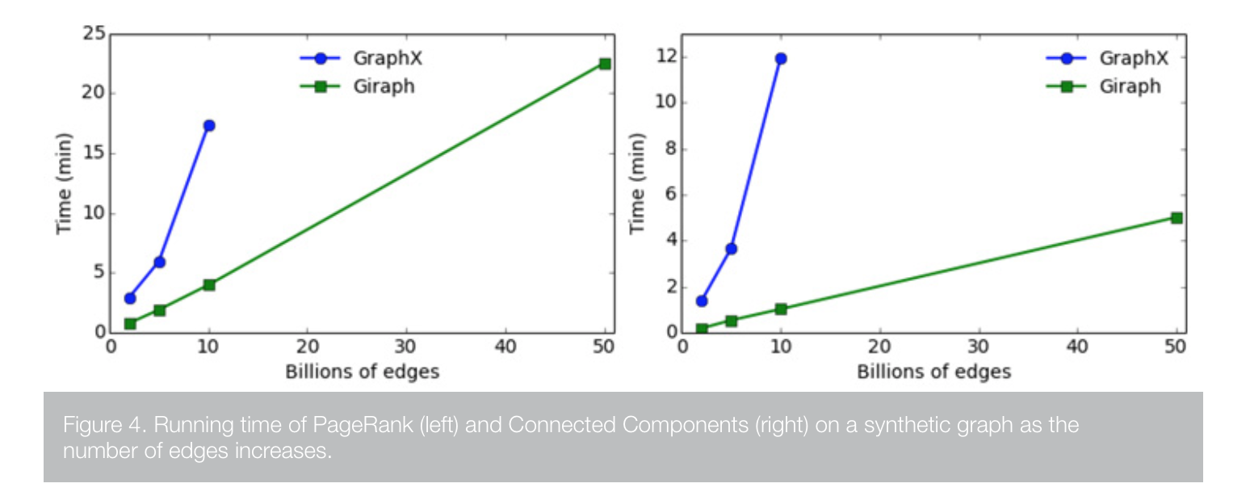
Facebook: A comparison of state-of-the-art graph processing systems
Giraph vs GraphX (19.10.2016)

Slide 41
Zadania
Repozytorium z kodem: https://github.com/rafalgrm/spark
Dane do pobrania w katalogu data: Marvel-graph.txt, Marvel-names.txt
Porównanie ‘pure Spark’ vs Spark + GraphX w prostych zadaniach przetwarzania grafów
Wykonanie wbudowanego w bibliotekę GraphX algorytmu grafowego na większym datasecie (jak starczy czasu)

Slide 42
Zbiory danych
Marvel-names.txt:
1 "24-HOUR MAN/EMMANUEL" 2 "3-D MAN/CHARLES CHAN" 3 "4-D MAN/MERCURIO" 4 "8-BALL/" 5 "A" 6 "A'YIN" 7 "ABBOTT, JACK" 8 "ABCISSA" 9 "ABEL"
Marvel-graph.txt:
5988 748 1722 3752 4655 5743 1872 3413 5527 6368 6085 4319 4728 1636 2397 3364 4001 1614 1819 1585 732 2660 3952 2507 3891 2070 2239 2602 612 1352 5447 4548 1596 5488 1605 5517 11 479 2554 2043 17 865 4292 6312 473 534 1479 6375 4456 5989 4080 4264 4446 3779 2430 2297 6169 3530 3272 4282 6432 2548 4140 185 105 3878 2429 1334 4595 2767 3956 3877 4776 4946 3407 128 269 5775 5121 481 5516 4758 4053 1044 1602 3889 1535 6038 533 3986 5982 217 595 1194 3308 2940 1815 794 1503 5197 859 5096 6039 2664 651 2244 528 284 1449 1097 1172 1092 108 3405 5204 387 4607 4545 3705 4930 1805 4712 4404 247 4754 4427 1845 536 5795 5978 533 3984 6056 5983 1165 3836 4361 1282 716 4289 4646 6300 5084 2397 4454 1913 5861 5485 5980 2731 3712 1587 6084 2472 2546 6313 875 859 323 2664 1469 522 2506 2919 2423 3624 5736 5046 1787 5776 3245 3840 2399

Slide 43
Wyświetl nazwę bohatera występującego z największą liczbą innych postaci
Preprocessing danych - mapowanie każdej linijki inputu do krotki: (heroId, # of occurrences)
Redukcja wyrazów po kluczu (heroId)
Znalezienie maksymalnej wartości # of occurrences
Znalezienie nazwy superbohatera
Notebook: MostPopularHero/MostPopularHero.ipynb Plik źródłowy: src/exercises/MostPopularHero.scala

Slide 44
Wyświetl nazwę bohatera występującego z największą liczbą innych postaci
/* given line extracts heroID -> number of connections tuple*/
def countCoOccurences(line:String) = {
var elements = line.split("\\s+")
(elements(0).toInt, elements.length-1)
}
/* given line extracts heroID -> heroName tuple */
def parseNames(line:String):Option[(Int, String)] = {
var fields = line.split("\"")
if (fields.length > 1) {
Some(fields(0).trim.toInt, fields(1))
} else {
None
}
}
// create SparkContext with use of every core on our local machine
val sc = new SparkContext("local[*]", "MostPopularHeroContext")
// heroID -> name RDD
val namesRdd = sc.textFile("Marvel-names.txt").flatMap(parseNames)
// heroID -> number of connections RDD
val pairings = sc.textFile("Marvel-graph.txt").map(countCoOccurences)
// TODO --- calculating result
// make reduction of the same heroID RDDs
// extracting result
// TODO ^^^ calculating result

Slide 45
Wyświetl nazwę bohatera występującego z największą liczbą innych postaci
// TODO --- calculating result
// make reduction of the same heroID RDDs
val totalFriendsByCharacters = pairings.reduceByKey((x,y) => x+y)
…

Slide 46
Wyświetl nazwę bohatera występującego z największą liczbą innych postaci
// TODO --- calculating result
// make reduction of the same heroID RDDs
val totalFriendsByCharacters = pairings.reduceByKey((x,y) => x+y)
// extracting result
val flipped = totalFriendsByCharacters.map(x => (x._2, x._1))
val mostPopular = flipped.max
val mostPopularName = namesRdd.lookup(mostPopular._2)
println(mostPopularName(0))
// TODO ^^^ calculating result

Slide 47
2. Wyświetl nazwę bohatera występującego z największą liczbą innych postaci (GraphX)
Preprocessing danych:
Stworzenie VertexRDD (VertexId -> name of hero)
Zmapowanie Marvel-graph.txt do listy obiektów Edge (EdgeRDD): (List[Edge[Int]])
Zbudowanie grafu Graph(verts, edges, default)
Analiza grafu - znalezienie 10 bohaterów o najwyższych stopniach w grafie
Notebook: MostPopularHero/MostPopularHeroGraph.ipynb Plik źródłowy: src/exercises/MostPopularHeroGraph.scala

Slide 48
2. Wyświetl nazwę bohatera występującego z największą liczbą innych postaci (GraphX)
def parseNames(line:String):Option[(VertexId, String)] = {
var fields = line.split("\"")
if (fields.length > 1) {
val heroId:Long = fields(0).trim.toLong
if (heroId < 6487) {
return Some(fields(0).trim.toLong, fields(1))
}
}
None
}
def makeEdges(line:String):List[Edge[Int]] = {
import scala.collection.mutable.ListBuffer
var edges = new ListBuffer[Edge[Int]]()
val fields = line.split(" ")
val origin = fields(0)
for (x <- 1 to (fields.length-1)) {
edges += Edge(origin.toLong, fields(x).toLong, 0)
}
edges.toList
}
val sc = new SparkContext("local[*]", "MostPopularHeroGraphCtx")
// vertices
val names = sc.textFile("Marvel-names.txt")
val vertices = names.flatMap(parseNames)
// edges
val lines = sc.textFile("Marvel-graph.txt")
val edges = lines.flatMap(makeEdges)
// graph
val default = "Nobody"
val graph = Graph(vertices, edges, default).cache()
// get top 15 most-connected heroes
// TODO your code goes here

Slide 49
2. Wyświetl nazwę bohatera występującego z największą liczbą innych postaci (GraphX)
graph.degrees.join(vertices).sortBy(_._2._1, ascending = false).take(15).foreach(println)

Slide 50
3. Policz stopień oddalenia (odległość) pomiędzy SpiderManem i ADAM-em (?) implementując BFS
Preprocessing danych:
Stworzenie krotki (id, connections, distance, color) (color = WHITE, GRAY, BLACK)
Implementacja BFS:
Szukamy szarych nodów
Aktualizujemy stany sąsiadów zmieniając ich kolor na szary
Kolorujemy na czarno wyjściowy node
BFS jako operacja Map-Reduce:
MAP: Każdy szary node => nowe nody dla każdego połączenia z odległością zwiększoną o 1, szarym kolorem i bez połączeń + node wejściowy zmieniony kolor na czarny
REDUCE: łączymy każdy node z tym samym heroId, zachowując najmniejszą odległość i najciemniejszy kolor oraz wszystkie połączenia
Kiedy kończymy? Accumulator!
Notebook: MostPopularHero/DegreesOfSeparation.ipynb Plik źródłowy: src/exercises/DegreesOfSeparation.scala

Slide 51
3. Policz stopień oddalenia (odległość) pomiędzy SpiderManem i ADAM-em (?) implementując BFS
/* convertion line from input file to bfs node */
def convertToBFS(line:String):BFSNode = {
val fields = line.split("\\s+")
val id = fields(0).toInt
var connections:ArrayBuffer[Int] = ArrayBuffer()
for (connection <- 1 to (fields.length-1)) {
connections += fields(connection).toInt
}
var color:Color.Color = Color.WHITE
var distance:Int = Int.MaxValue
if (id == startCharId) {
color = Color.GRAY
distance = 0
}
(id, (connections.toArray, distance, color))
}
def createStartingRDD(sc:SparkContext): RDD[BFSNode] = {
sc.textFile("Marvel-graph.txt").map(convertToBFS)
}
val sc = new SparkContext("local[*]", "DegreesOfSeparationContext")
hitCounter = Some(sc.accumulator(0))
var iterationRDD = createStartingRDD(sc)
var iteration:Int = 0
for (iteration <- 1 to 10) {
println("BFS Iteration " + iteration)
val mapped = iterationRDD.flatMap(BFSMap)
println("Processing " + mapped.count() + " values.")
if (hitCounter.isDefined) {
val hitCount = hitCounter.get.value
if (hitCount > 0) {
println("Hit the target counter! From " + hitCount + " different directions")
}
return
}
// reducer work
iterationRDD = mapped.reduceByKey(BFSReduce)
}
// TODO --- print results

Slide 52
// map function
// expands node into itself and its children
def BFSMap(node:BFSNode):Array[BFSNode] = {
val characterId = node._1
val data = node._2
val connections:Array[Int] = data._1
val distance:Int = data._2
var color:Color.Color = data._3
var result:ArrayBuffer[BFSNode] = ArrayBuffer()
if (color == Color.GRAY) {
for (conn <- connections) {
val newCharID = conn
val newDist = distance + 1
val newColor = Color.GRAY
// have we stumbled accross searched character?
if (targetCharId == conn) {
if (hitCounter.isDefined) hitCounter.get.add(1)
}
val newEntry:BFSNode = (newCharID, (Array(), newDist, newColor))
result += newEntry
}
// all nodes processed here...
color = Color.BLACK
}
val thisEntry:BFSNode = (characterId, (connections, distance, color))
result += thisEntry
result.toArray
}
def BFSReduce(data1:BFSData, data2:BFSData):BFSData = {
// extracting data we are combining
val edges1:Array[Int] = data1._1
val edges2:Array[Int] = data2._1
val dist1:Int = data1._2
val dist2:Int = data2._2
val color1:Color.Color = data1._3
val color2:Color.Color = data2._3
// default node values
var dist:Int = Int.MaxValue
var color:Color.Color = Color.WHITE
var edges:ArrayBuffer[Int] = ArrayBuffer()
// TODO --- TYPE YOUR CODE HERE
// merge edges
// preserve minimum distance
// preserve darkest color
// TODO ^^^ TYPE YOUR CODE HERE
// return result of reduction
(edges.toArray, dist, color)
}

Slide 53
3. Policz stopień oddalenia (odległość) pomiędzy SpiderManem i ADAM-em (?) implementując BFS
// TODO --- TYPE YOUR CODE HERE
// merge edges
if (edges1.length > 0) {
edges ++= edges1
}
if (edges2.length > 0) {
edges ++= edges2
}
// preserve minimum distance
dist = math.min(dist1, dist2)
// preserve darkest color
…
// TODO ^^^ TYPE YOUR CODE HERE

Slide 54
3. Policz stopień oddalenia (odległość) pomiędzy SpiderManem i ADAM-em (?) implementując BFS
// TODO --- TYPE YOUR CODE HERE
// merge edges
if (edges1.length > 0) {
edges ++= edges1
}
if (edges2.length > 0) {
edges ++= edges2
}
// preserve minimum distance
dist = math.min(dist1, dist2)
// preserve darkest color
if (color1 == Color.WHITE) color = color2
else if (color1 == Color.GRAY) {
if (color2 == Color.BLACK) color = color2
else color = color1
}
else color = color1
// TODO ^^^ TYPE YOUR CODE HERE
// TODO --- print results
println(iterationRDD.lookup(targetCharId)(0)._2)

Slide 55
4. Policz stopień oddalenia (odległość) pomiędzy SpiderManem i ADAM-em (GraphX + Pregel API)
Preprocessing danych dokładnie taki sam jak w poprzednim przykładzie z GraphX
Użycie modelu Pregel
Wierzchołki grafu wysyłają wiadomości do swoich sąsiadów
Graf jest procesowany w iteracjach zwanymi supersteps
W każdym superstepie:
Wiadomości z poprzednich iteracji są odbierane przez wierzchołek
Każdy wierzchołek przetwarza siebie na bazie tych wiadomości
Każdy wierzchołek wysyła wiadomości do innych wierzchołków
Notebook: MostPopularHero/DegreesOfSeparationGraph.ipynb Plik źródłowy: src/exercises/DegreesOfSeparationGraph.scala

Slide 56
4. Policz stopień oddalenia (odległość) pomiędzy SpiderManem i ADAM-em (GraphX + Pregel API)
def parseNames(line:String):Option[(VertexId, String)] = {
var fields = line.split("\"")
if (fields.length > 1) {
val heroId:Long = fields(0).trim.toLong
if (heroId < 6487) {
return Some(fields(0).trim.toLong, fields(1))
}
}
None
}
def makeEdges(line:String):List[Edge[Int]] = {
import scala.collection.mutable.ListBuffer
var edges = new ListBuffer[Edge[Int]]()
val fields = line.split(" ")
val origin = fields(0)
for (x <- 1 to (fields.length-1)) {
edges += Edge(origin.toLong, fields(x).toLong, 0)
}
edges.toList
}
def main(args: Array[String]): Unit = {
val sc = new SparkContext("local[*]", "MostPopularHeroGraphCtx")
// vertices
val names = sc.textFile("Marvel-names.txt")
val vertices = names.flatMap(parseNames)
// edges
val lines = sc.textFile("Marvel-graph.txt")
val edges = lines.flatMap(makeEdges)
// graph
val default = "Nobody"
val graph = Graph(vertices, edges, default).cache()
...

Slide 57
4. Policz stopień oddalenia (odległość) pomiędzy SpiderManem i ADAM-em (GraphX + Pregel API)
val initialGraph = graph.mapVertices((id, _) => if (id == root) 0.0 else Double.PositiveInfinity)
// pregel algorithm
// pregel sends initial message of PositiveInfinity to every vertex and we set up 10 iterations
// TODO --- correct pregel arguments
val bfs = initialGraph.pregel(Double.PositiveInfinity, 10) (
// program for vertex - it has to preserve the shortest distance between incoming message and current attribute
(id, attr, msg) => attr,
// send message function - propagates out to all neighbours every iteration
triplet => Iterator.empty,
// reduce operation - preserving minimum of messages received by vertex if it received more than one in each iteration
(a, b) => a
)
// TODO ^^^ correct pregel arguments
// get top 10 results
bfs.vertices.join(vertices).take(10).foreach(println)
// like in previous exercise SpiderMan to Adam
println("\n\nDegrees from SpiderMan to ADAM")
bfs.vertices.filter(x => x._1 == 14).collect.foreach(println)

Slide 58
Przykłady funkcji specjalizowanych z biblioteki GraphX
Użyjemy do naszego grafu dwóch funkcji:
pageRank() oraz triangleCount()
val sc = new SparkContext("local[*]", "MostPopularHeroGraphCtx")
// vertices
val names = sc.textFile("Marvel-names.txt")
val vertices = names.flatMap(parseNames)
// edges
val lines = sc.textFile("Marvel-graph.txt")
val edges = lines.flatMap(makeEdges)
// graph
val default = "Nobody"
val graph = Graph(vertices, edges, default).cache()
// calculating PageRank
// TODO your code goes here
// calcularing triangle count
// TODO your code goes here

Slide 59
PageRank in GraphX
// Run PageRank val ranks = graph.pageRank(0.0001).vertices // Join the ranks with the usernames val users = sc.textFile("data/graphx/users.txt").map { line => val fields = line.split(",") (fields(0).toLong, fields(1)) } val ranksByUsername = users.join(ranks).map { case (id, (username, rank)) => (username, rank) }

Slide 60
Triangle count - example
// Load the edges in canonical order and partition the graph for triangle count val graph = GraphLoader.edgeListFile(sc, "data/graphx/followers.txt", true) .partitionBy(PartitionStrategy.RandomVertexCut) // Find the triangle count for each vertex val triCounts = graph.triangleCount().vertices // Join the triangle counts with the usernames val users = sc.textFile("data/graphx/users.txt").map { line => val fields = line.split(",") (fields(0).toLong, fields(1)) } val triCountByUsername = users.join(triCounts).map { case (id, (username, tc)) => (username, tc) }

Slide 61
Przykłady funkcji specjalizowanych z biblioteki GraphX
// calculating PageRank
val ranks = graph.pageRank(0.001).vertices
ranks.join(vertices).sortBy(_._2._1, ascending = false).take(20).foreach(println)
// calcularing triangle count
val graphPartiotioned = graph.partitionBy(PartitionStrategy.RandomVertexCut)
val triCounts = graph.triangleCount().vertices
triCounts.join(vertices).sortBy(_._2._1, ascending = false).take(20).foreach(println)

